Slide 1
Research Misconduct and
Academic Writing Skills
Instructor: _____________

Slide 2
Table of Contents
Unit Introduction
1. The Definition of Misconduct
2. Types of Research Misconduct
2.1. Inappropriate Data Collection
2.2. Data Fabrication and Falsification
2.3. Plagiarism
2.3.1. The Writing Skill of Paraphrasing
2.3.2. The Writing Skill of Summarizing
2.3.3. The Writing Skill of Quoting
2.4. Inappropriate Authorship
2.4.1. Inappropriate Authorship and Designation
2.5. Duplicate Submission and Publication
3. Conclusion
Quiz
References
p. 3-7
p. 8-10
p. 11-12
p. 13-21
p. 22-27
p. 28-37
p. 38-46
p. 47-54
p. 55-61
p. 62-72
p. 73-76
p. 77-81
p. 82-86
p. 87-93
p. 94-97

Slide 3
Unit Introduction

Slide 4
Unit Introduction (1/4)
The history of research ethics dates back to the 1980s when several forms of research misconduct were identified in the United States forcing the American government to begin addressing the issue of research ethics and causing many scholars worldwide to begin examining their own research practices.
Even today, cases that violate research ethics are still found. Therefore, this unit will define research misconduct and introduce the common types of irresponsible research behaviors.

Slide 5
Unit Introduction (2/4)
Before beginning thesis writing, a researcher often spends time collecting information via various means. Given that modern network information is diverse and easily accessible to everyone, typing a few keywords will quickly provide a lot of relevant information for use. If a researcher does not understand how to correctly cite or interpret the information, he/she can easily commit plagiarism.
Note: The examples illustrated in this unit are based on the APA formatting style (6th edition) published by the American Psychological Association, 2010.

Slide 6
Unit Introduction (3/4)
In both Chinese and English writing, there are three ways to avoid plagiarism, namely quoting, paraphrasing, and summarizing. This unit will also introduce appropriate thesis writing skills that help researchers avoid plagiarism and utilize information correctly.
Note: The examples illustrated in this unit are based on the APA formatting style (6th edition) published by the American Psychological Association, 2010.

Slide 7
Unit Introduction (4/4)
Unit Objectives
The completion of this unit will allow researchers to achieve the following goals:
  Understand the definition and types of research misconduct.
  Understand the types of research misconduct that should be avoided when conducting research.
  Understand three academic writing skills to avoid plagiarism : paraphrasing, summarizing, and quoting.

Slide 8
1.
The Definition of
Misconduct

Slide 9
1. The Definition of Misconduct (1/2)
What is research misconduct?
Research misconduct refers to practices that a researcher is aware of but deliberately and significantly deviates from the generally accepted research behavior (Wencong Qiu complied, 2009).
According to the Federal Research Misconduct Policy issued by the Offices of Science and Technology Policy, research misconduct is defined as fabrication, falsification, or plagiarism (abbreviated as FFP) in proposing, performing, or even reviewing research, or in reporting research results (Office of Research Integrity, 2000).

Slide 10
1. The Definition of Misconduct (2/2)
However, research misconduct is complicated: the avoidance of FFP is the baseline; other types of misconduct should be regulated and avoided as well. In the following section, we will introduce five types of research misconduct.

Slide 11
2.
Types of Research Misconduct

Slide 12
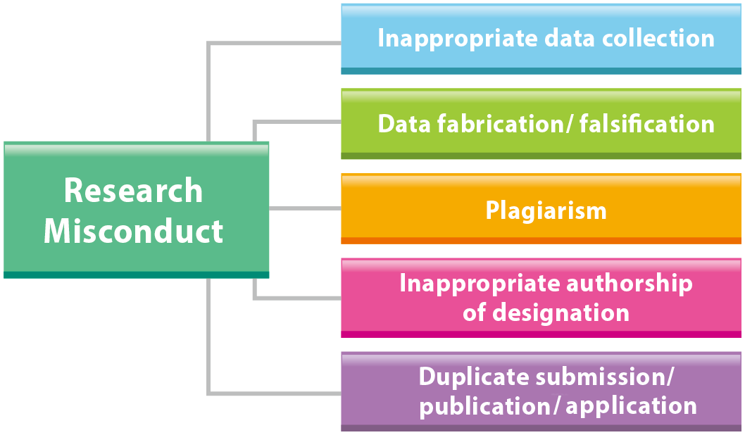
2. Types of research misconduct
Depending on the research stage, research misconduct can be divided into five types namely:
  inappropriate data collection
  fabrication (falsification) of lab data
  plagiarism
  inappropriate authorship or designation
  duplicate submission, publication, and application.
  These five types of research misconduct are illustrated below.

Slide 13
2.1.
Inappropriate Data Collection

Slide 14
Q&A – Q1
Think About it
Without the consent of the author, Guang duplicated parts of data and content from that article and pasted to his own report. Is this appropriate?
If not, what should Guang have done?

Slide 15
Q&A – Q2
Think About it
Is it right that Joe ignored the malfunction message of his equipment, continued his experiment, and used the inaccurate data in his research report?
If not, what should he have done?

Slide 16
2.1. Inappropriate Data Collection (1/6)
There are two types of inappropriate data collection.
  The first type involves collecting data from living animals or humans and causing physical or psychological discomfort, pain, or death during the whole research process.
  The second type is collecting data from non-living objects and producing problematic data due to human error or equipment malfunction.

Slide 17
2.1. Inappropriate Data Collection (2/6)
The first type of inappropriate data collection occurs when conducting research on human subjects. If researchers do not clearly inform the research subjects about the purposes and the process of the research, or do not obtain their consent, it would not only call into question the authority of the data, but it could harm the subjects both psychologically and physically.
Even if the experiment is non-intrusive or of low risk, such as tracking eye movements or measuring brave waves, researchers should still adhere to the basic principles of research ethics to protect the authenticity of the data and the rights of research subjects.

Slide 18
2.1. Inappropriate Data Collection (3/6)
In general, research projects involving animals or human subjects are more complex. In addition to general research ethics, researchers are expected to abide by laws such as the “Act on Human Subject Research” and the “Animal Protection Act.”

Slide 19
2.1. Inappropriate Data Collection (4/6)
The second type of inappropriate data collection can occur when data are collected from non-living objects. This form of research is often undertaken in the fields of electronics and engineering, information technology, natural science, or engineering.
In this type of research, inappropriateness usually occurs as a result of research subjects or researchers not following experimental procedures or the proper steps to operate equipment, or otherwise lacking knowledge about using the lab. Sometimes it happens because of equipment malfunction or calibration failure, resulting in an inaccurate record/documentation.

Slide 20
2.1. Inappropriate Data Collection (5/6)
To collect, analyze and store data in an appropriate way is a basic professional responsibility of a researcher. Researchers should pay attention to every step throughout the process of data collection.
In contrast, if researchers do not pay attention to the details of this process, other researchers might question their research results, which could both damage their credibility and require remedial measures, such as modifying or redoing the research, which could be seen as overly time-and effort-consuming and as a waste of social resources.

Slide 21
2.1. Inappropriate Data Collection (6/6)
Moreover, even if the researcher is given the opportunity to modify or redo the research, it might have already done harm to the subjects both physically and psychologically. A bad data could also lead other researchers into false interpretations, or cause legislative and administrative units to draft improper policies.
Therefore, to ensure the accuracy of the research and to protect other people from misinformation, researchers should pay more attention to the design and planning of their research, examine whether the process fulfills the research ethics requirements, ensure the fairness and quality of the results, and protect the basic rights of all stakeholders.

Slide 22
2.2.
Data Fabrication and Falsification

Slide 23
Q&A – Q3
Think About it
Is it appropriate that Shin falsified research data only because the original data did not fit the research hypothesis?
If Shin had decided not to falsify the data, what else could he have done to meet his advisor's expectations?

Slide 24
Q&A – Q4
Think About it
Is it appropriate that Flora used a photo of irrelevant objects as a photo of the research results?
Would there have been any other way to finish the observation report before the deadline?

Slide 25
2.2. Data Fabrication and Falsification (1/3)
Data fabrication and data falsification both violate research ethics. Fabrication involves researchers making up data, including visual graphics, figures, or research processes, as research results and including them in publications.
Falsification involves researchers deliberately manipulating research data, figures, processes, and equipment to support claims, hypotheses or other data. Falsification also includes hiding research results that do not meet the expected outcomes or tweaking the data to make the results prettier, resulting in misrepresentation of the research results.

Slide 26
2.2. Data Fabrication and Falsification (2/3)
During the research process, researchers should never operate equipment inappropriately or falsify data, charts, and other content due to lack of time, pressure from publications, or the search for perfect results.

Slide 27
2.2. Data Fabrication and Falsification (3/3)
In recent years, the journal review mechanism has become more rigorous. In addition, due to rapid information transmission, every published research thesis can now be conveniently accessed by a larger audience; therefore, fabrication or falsification of data can easily be caught
It is important to conduct research with integrity. If a researcher is found fabricating or falsifying research results, not only will it damage the public's trust in academia but the researcher will also suffer criticism from the public leaving his/her research career in permanent disgrace.

Slide 28
2.3.
Plagiarism

Slide 29
Q&A – Q5
Think About it
Is it appropriate that Guang copied the Web articles and used them in his report?
Is there another way to cite others’ articles rather than simply copying-and-pasting?

Slide 30
2.3. Plagiarism (1/2)
Plagiarism is a common type of research misconduct. According to the Oxford dictionary, plagiarism means “The practice of taking some else's work or ideas and passing them off as one's own” (Oxford University Press, 2015).
Plagiarism refers to the act of copying and using others’ published works, including text and graphics, without clearly stating the source (Steneck, 2007).
In addition, direct translation of others' work without giving credit to the original authors also constitutes plagiarism.

Slide 31
2.3. Plagiarism (2/2)
To avoid plagiarism, researchers must not only cite their sources but also use appropriate writing strategies to compose their papers, such as “quotation,” “citation,” and “summarizing.”
The most common form of plagiarism is “inappropriate citation,” which refers to the act of (1) slightly modifying the original text and using it as one’s own, or (2) translating an entire paper into another language word for word, and yet only citing it as a reference.

Slide 32
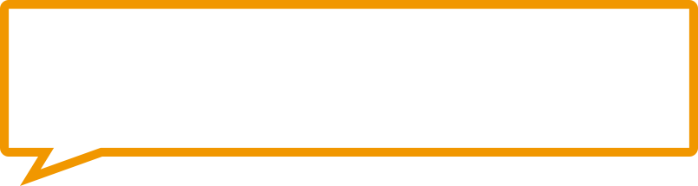
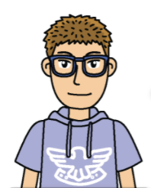
Q&A – Q6-1
Think About it
In different scenarios, which action is most acceptable by the public?
  Joe was very interested in a research article published in 1990, and he wanted to use the same research methods to conduct his own research so he could compare the differences.
I have to cite the article and state my research objectives. Follow the same procedure again and compare the two research results.
Q6-1: Is Joe's decision and action appropriate?
Joe

Slide 33
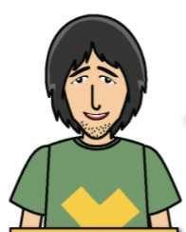
Q&A – Q6-2
Think About it
In different scenarios, which action is most acceptable by the public?
  Guang was analyzing data, and he needed data from the five-year-old national population to compare with his own. Guang followed Flora‘s advice and retrieved the information he needed from the website of the Department of Statistics of the Ministry of Education.
These charts were made by the government for public use. So, I can simply copy the charts and use them in my research paper for further analysis.
Q6-2: Is Guang's decision and action appropriate?
Guang

Slide 34
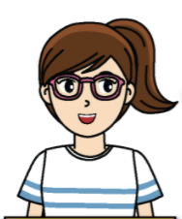
Q&A – Q6-3
Think About it
In different scenarios, which action is most acceptable by the public?
  Shelly could not come up with a topic for her thesis. Following Cindy's suggestion, she went to the library to look at predecessors' works for inspiration, and she found one particular thesis from abroad that matched her interest.
I plan to translate a thesis into Chinese, adopt the research ideas and research procedure described in this thesis, and directly use the data of in my thesis since when I don't have sufficient data so far. What a brilliant idea.
Q6-3: Is Shelly's decision and action appropriate?
Shelly

Slide 35
Q&A
Your Answer is Correct!
Go to Q6-1
Go to Q6-2
Go to Q6-3

Slide 36
Q&A
Your Answer is Incorrect!
Go to Q6-1
Go to Q6-2
Go to Q6-3

Slide 37
2.3. Plagiarism
It is inevitable that researchers will borrow others' ideas and words when composing manuscripts, but they should always remember to quote or cite their sources. As long as one gives credit to the sources and applies summarizing and paraphrasing strategies, one can be free from potential plagiarism.
Currently, with the advancement of technology, it has become easier to obtain and copy information. However, the technology of detection is quite advanced as well, and it is now being widely used. If one intends to plagiarize others’ works, it will be easy to discover, and it may be in violation of the Copyright Act. For researchers, this practice will only bring negative consequences.

Slide 38
2.3.1
The Writing Skill of Paraphrasing

Slide 39
2.3.1 The Writing Skill of Paraphrasing (1/8)
In thesis writing, both in Chinese and English, changing words such as “when” in the original text to “at” or “during,” or altering “professor” to “teacher,” is not considered authentic paraphrasing.

Slide 40
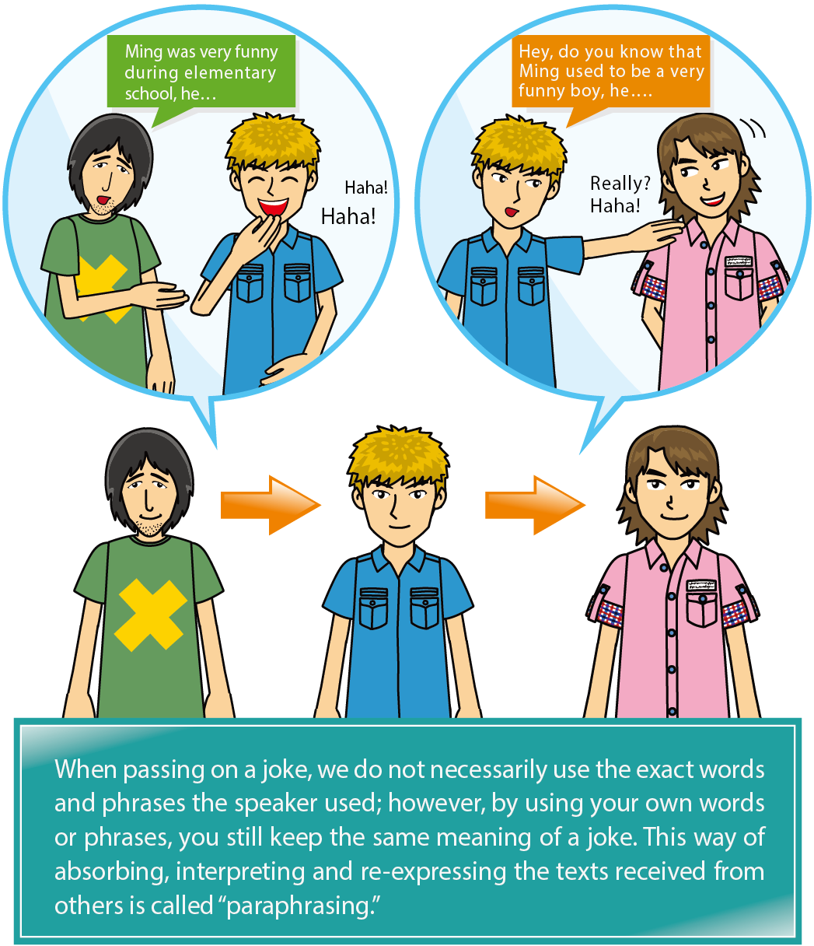
2.3.1 The Writing Skill of Paraphrasing (2/8)
Meaning of paraphrasing
Please take a moment to recall if you have ever shared a joke you heard from others. If so, did you hear about the joke from a friend or an online forum?

Slide 41
2.3.1 The Writing Skill of Paraphrasing (3/8)
Paraphrasing is a writing skill that involves rewriting a text or passage with the same meaning but using your own words. When paraphrasing, it is necessary to sort out papers from different sources and merge them to reproduce the original meaning and connotation of the papers without distorting the authors’ perspectives but adding your own explanations and interpretations (Zuo-wei Zhang, 2007；Ballard & Clanchy, 1991; Sperber & Wilson, 1995）.
In sum, “paraphrasing” is a writing skill in which you convey the concept of the source text in your own words while showing respect to the author’s main ideas.

Slide 42
2.3.1 The Writing Skill of Paraphrasing (4/8)
Rules to follow and mistakes to avoid when paraphrasing:
Mistakes to avoid
If the following 5 scenarios occurred when citing others‘ papers, the writer could be considered to be plagiarizing. (In these scenarios, most of the writers merely copied the original texts or added / deleted some words.) Copy exact language from a source (usually more than 5 to 9 words) without modifying it or using an appropriate citation or quotation marks. Use synonyms as substitutes for the original words. Merely add one to two words to the original text. Merely delete one to four words from the original text. Merely switch the order of the original sentences or just slightly change the structures of the original paragraphs. Source: Walker (2008)
Rules to follow
The writer has to identify the key words and views, understand the meaning and the structure of the paper, and rewrite it in his/her own words. Understand the meaning of the paper. Identify the key words and views, trim unnecessary words, and rewrite the topic in the writer's own. Use proper punctuation according to the meaning and the structure of the sentences paraphrased. Avoid using the exact same words of more than one clause from the original text. Source: 楊晉綺 (2010)

Slide 43
2.3.1 The Writing Skill of Paraphrasing (5/8)
Example of paraphrasing
Please read the original texts and the two paraphrased versions. Evaluate the quality of the paraphrased versions:
Which version is a better paraphrase and is free of plagiarism?

Slide 44
2.3.1 The Writing Skill of Paraphrasing (6/8)
Original text
As the cost of portable wireless access to the Internet becomes affordable for everyone, the concern will be about the educational digital divide that separates those students who are taught by technology-savvyt eachers from those who are not. The development of these ubiquitous computing environments for students presents exciting challenges for teacher education programmes. It seems reasonable to provide programmes or training that focuses on both competencies and visions for both pre-service and in-service teachers (Peng, Su, Chou, & Tsai, 2009,p.177).
The above text is taken from the research paper of Peng, H.. Su, Y-J. Chou, C., & C-C, Tsai.(2009). Ubiquitous knowledge construction: mobile learning re-defined and a conceptual framework. Innovations in Education and Teaching International, 46(2), 171-183.

Slide 45
2.3.1 The Writing Skill of Paraphrasing (7/8)
Example of paraphrasing
When the researcher intends to cite this paragraph, he/she can try to identify the keywords or key sentences from the original text and employ them to identify their relationship to ensure that an effective paraphrasing strategy is achieved.

Slide 46
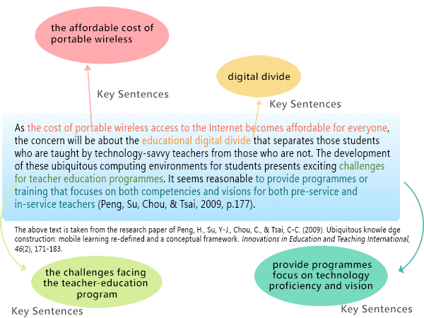
2.3.1 The Writing Skill of Paraphrasing (8/8)
Paraphrase

Slide 47
2.3.2
The Writing Skill of Summarizing

Slide 48
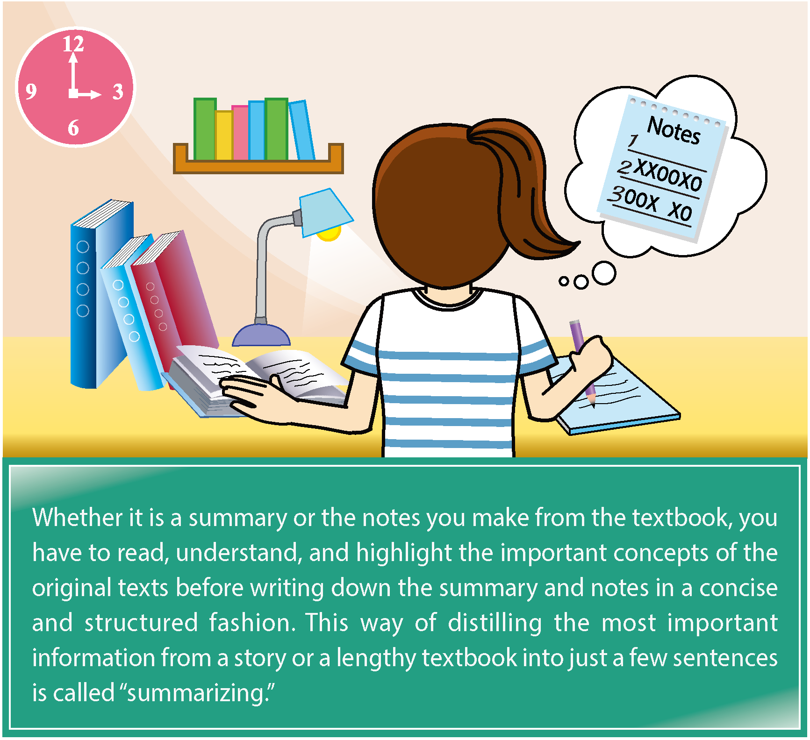
2.3.2 The Writing Skill of Summarizing (1/7)
Please take a moment to recall if you have ever shared a joke you heard from others. If so, did you hear about the joke from a friend or an online forum?

Slide 49
2.3.2 The Writing Skill of Summarizing (2/7)
The Definition of Summarizing
The “summarizing” skill refers to a “brief restatement of an author's words that conveys only the author’s main point(s)” (Duke University, n.d.). Summarizing often involves cutting down a long paragraph or identifying the main ideas of a book or a long online article. As a result, in Chinese we often call summarizing “writing key points,” which means to condense an article into a short and succinct summary.

Slide 50
2.3.2 The Writing Skill of Summarizing (3/7)
The Definition of Summarizing
When making a summary, you should follow three basic rules (楊晉綺, 2010; Stern, 2007):
  Use neutral and concise words.
  Avoid using too many sentences from the original text.
  Apply quotation marks when using exact words or phrases from the original text.

Slide 51
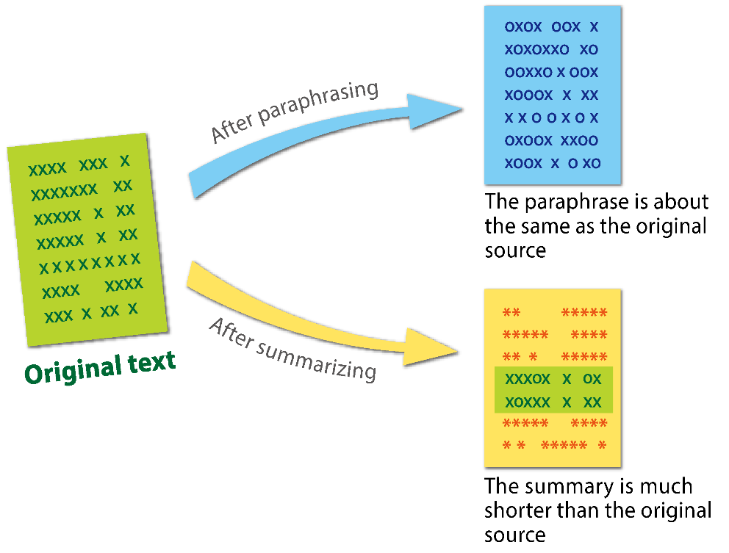
2.3.2 The Writing Skill of Summarizing (4/7)
The Difference between Paraphrasing and Summarizing
Summarizing and paraphrasing are a little bit different. In general, the length of a paraphrase is about the same as the original text, while a summary is much shorter. (Massachusetts Institute of Technology, 2010)

Slide 52
2.3.2 The Writing Skill of Summarizing (5/7)
The Difference between Paraphrasing and Summarizing
The following summaries are written in APA format. Please compare the original text with the text summarized.
Let's look at the English example and then compare the following original text with the summary.

Slide 53
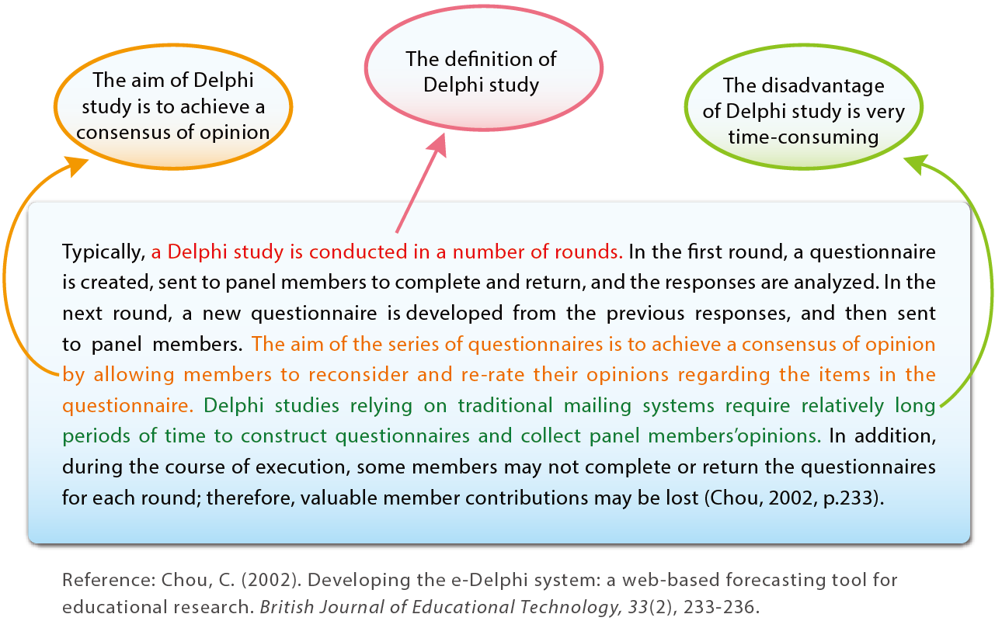
2.3.2 The Writing Skill of Summarizing (6/7)
Original text - English example

Slide 54
2.3.2 The Writing Skill of Summarizing (7/7)
Summary
As stated in Chou (2002), the Delphi method uses mailing systems to identify consensus among experts regarding research questions. After the responses are analyzed and synthesized, a researcher develops a new questionnaire, sends it to experts, and modifies the research questions. However, opinion collection and questionnaire revision are time-consuming which may result in the fragmentary of the expert-response procedure.
Reference: Chou, C. (2002). Developing the e-Delphi system: a web-based forecasting tool for educational research. British Journal of Educational Technology, 33(2), 233-236.

Slide 55
2.3.3
The Writing Skill of Quoting

Slide 56
2.3.3 The Writing Skill of Quoting (1/6)
Please recall how often you mention any of the following in your daily conversations:

Slide 57
2.3.3 The Writing Skill of Quoting (2/6)
This method of using the quotations of others to enrich your own speech content is the skill of “quoting.”
“Quoting” means the direct use of someone else’s words in an article. APA format specifies two types of citation methods—“in-text direct quotes” and “block quotes”—depending upon whether the quotation is under or over 40 words (American Psychological Association, 2010).
If under 40 words: Incorporate the quotation into the text, and cite the source.

Slide 58
2.3.3 The Writing Skill of Quoting (3/6)
Incorporate the quotation into the text, and enclose the quotation in double quotation marks.
Example
The term “method”, defined by Edward Anthony (1963) as ”an overall plan for systematic presentation of language based upon a selected approach” (as cited in Brown, 2001, p. 14), is still widely used among language instructors nowadays.
References: Brown, H.D. (2001). Teaching by principles: An interactive approach to language pedagogy (2nd ed.). White Plains, NY: Longman.

Slide 59
2.3.3 The Writing Skill of Quoting (4/6)
Alternately, italicize the quotation.
Example
The term “method”, defined by Edward Anthony (1963) as an overall plan for systematic presentation of language based upon a selected approach (as cited in Brown, 2001, p. 14), is still widely used among language instructors nowadays.
References: Brown, H.D. (2001). Teaching by principles: An interactive approach to language pedagogy (2nd ed.). White Plains, NY: Longman.

Slide 60
2.3.3 The Writing Skill of Quoting (5/6)
In quotes more than 40 words, the quotation is in an individual paragraph without quotation marks but the source must be cited as illustrated below:
  Use block quotation.
  Omit quotation marks.
  Indent the quotation from the left margin.

Slide 61
2.3.3 The Writing Skill of Quoting (6/6)
Please refer to the following example:
Conflict, competition and cooperation, as proposed by Deutsch (2005), are the three essential elements in a group or a team. He gave his own explanation of how they are interrelated :
  Although competition produces conflict, not all instances of conflict reflect competition…. Conflict can occur in a cooperative or a competitive context, and the processes of conflict resolution that are likely to be displayed will be strongly influenced by the context within which the conflict occurs (Deutsch, 2005, p.2).
References:Deutsch, M. (2005). Cooperation and conflict: A personal perspective on the history of the social psychological study of conflict resolution. In M.A. West, D. Tjosvold, & K.G., Smith. (Eds.), The essentials of teamworking: International perspectives (pp. 1-35). West Sussex, UK: Wiley.

Slide 62
2.4.
Inappropriate Authorship

Slide 63
2.4. Inappropriate Authorship (1/5)
In recent years, most research requires various areas of expertise and teams of researchers from different disciplines. As a result, the definition of authorship has become an important issue in research ethics.
Many university faculty and graduate students in Taiwan must fulfill research performance requirements for promotion or graduation.

Slide 64
2.4. Inappropriate Authorship (2/5)
Therefore, to accelerate the process of publishing findings, inappropriate assignment of authorship can occur. However, what exactly is inappropriate assignment, and what defines authorship? Simply put, these two terms refer to “an intentional and untruthful listing of author names.”
Possible problematic assignments of authorship include unfaithful listing of authors who might not deserve to be listed, of those whose permission has not been granted, and those who have ghostwritten the manuscript.

Slide 65
2.4. Inappropriate Authorship (3/5)
The Definition of Authors
Who do you think can qualify as an author of a paper?
According to the American Psychological Association, authorship is not limited to the individual who actually composed the manuscript: it also includes individuals who have made substantial contributions to the research, such as drafting research questions or hypotheses, organizing and conducting statistical analysis, and analyzing and interpreting the results.

Slide 66
2.4. Inappropriate Authorship (4/5)
The Definition of Authors
However, those who have only contributed a single task, such as coaching statistical analysis, collecting or inputting data for entry, modifying or writing computer software, or recruiting research subjects, should be listed in the acknowledgments section but not as authors.

Slide 67
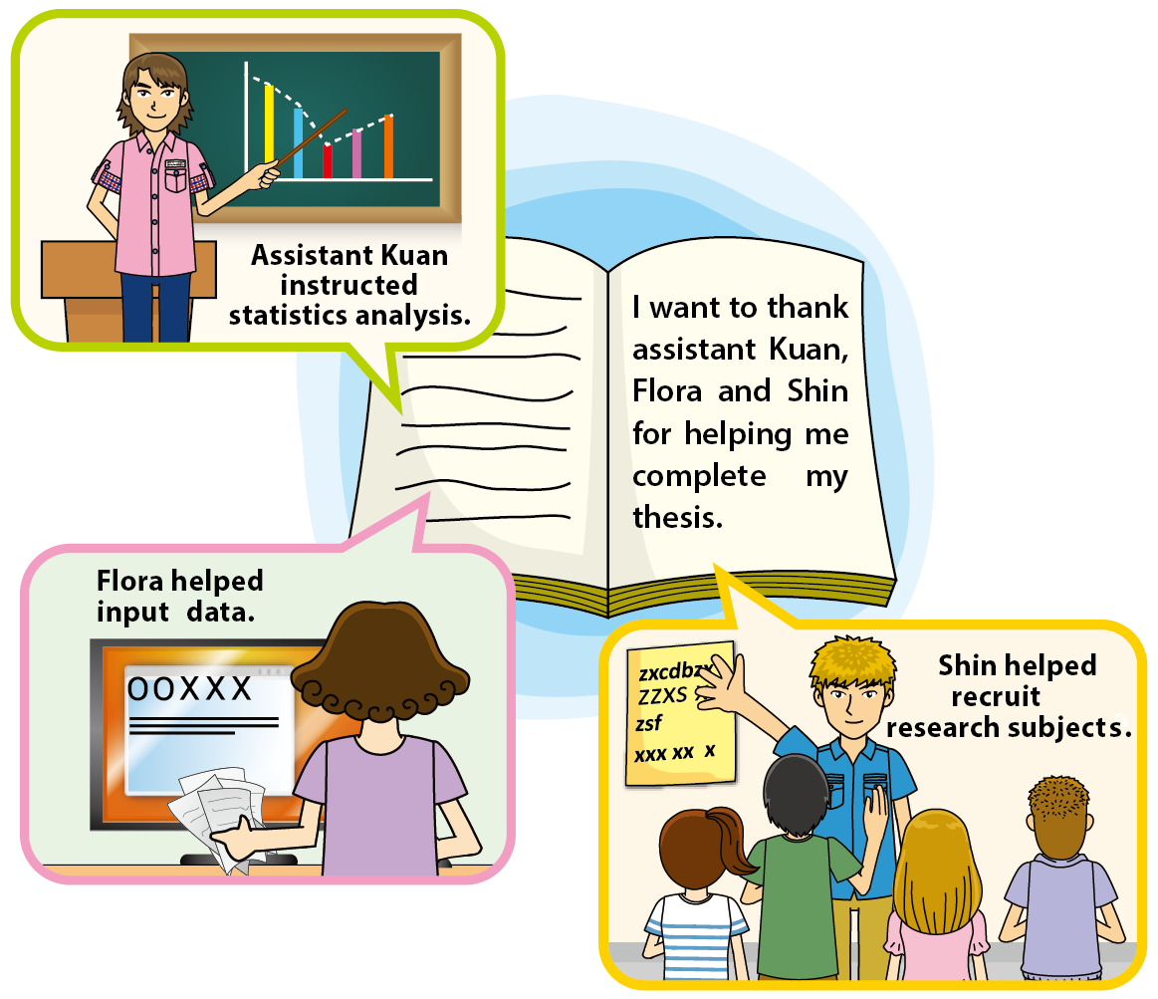
2.4. Inappropriate Authorship (5/5)

Slide 68
Q&A – Q7 (1/3)
Think About it
Shin is a graduate student at an information research institute. While writing his thesis, Shin met many individuals who offered him a lot of assistance and valuable advice. Who can be listed as co-authors?
(see the next page for the figure)

Slide 69
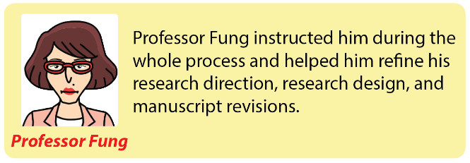
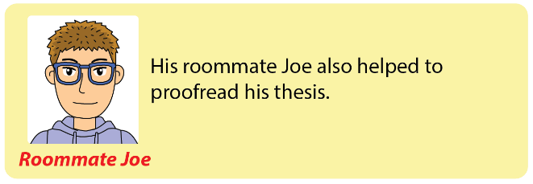
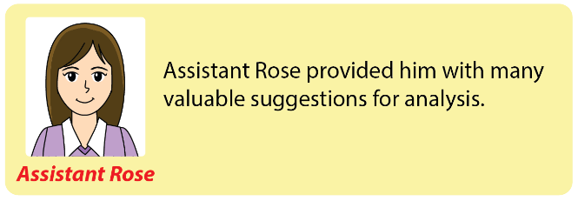
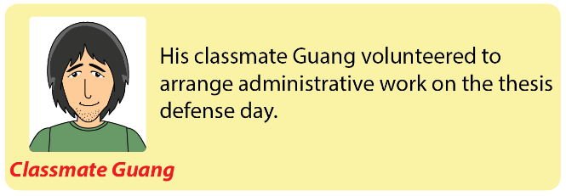
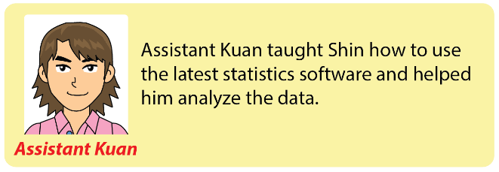
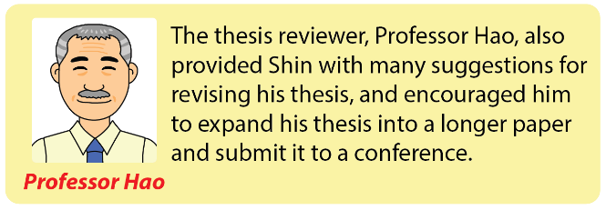
Q&A – Q7 (2/3)

Slide 70
Q&A – Q7 (3/3)
(continued)
After revising the thesis manuscript, Shin talked to Professor Fung about submitting a paper to a conference. They decided to use some of the data in the thesis to conduct further statistical analysis, and put all of the results together, turning them into a paper and submitting it to a conference in the field of information technology.
With so much assistance from others throughout the process, Shin wondered who qualified as an author of the submitted paper and who should be included in the acknowledgments section.

Slide 71
Q&A – Q7 (1/2)
Think About it
If you were Shin, who would you list as a co-author of the conference paper?
And who should be mentioned in the acknowledgments section?

Slide 72
In general, it is honorable to be listed as the co-author if one has made a substantial contribution to the paper.
Regardless of the order of authorship, all listed authors should consent to and be responsible for the final submission of the paper.
In a sense, when the paper is questioned, all of the listed authors share collective responsibility. The honor is shared, and so is the responsibility.

Slide 73
2.4.1
Inappropriate Authorship and Designation

Slide 74
2.4.1 Inappropriate authorship and designation (1/3)
What is inappropriate authorship and designation? Essentially, inappropriate authorship and designation can be divided into two scenarios.
  An honorary author, also known as guest author who is listed as an author but has not made any significant contribution to the paper. He/she is mentioned only out of courtesy and due to his/her reputation in the related field.
  A ghost author is someone who has substantially contributed but is not listed as an author.
  However, both scenarios constitute inappropriate authorship that violates the fundamental spirit of truth seeking in research ethics and academic research.

Slide 75
2.4.1 Inappropriate authorship and designation (2/3)
A thesis is the final product of the tireless efforts of academic researchers. To qualify to be listed as an author, a researcher must substantially contribute to the research results.
Authors of a paper share both the acclaim and responsibilities.
Before putting together the manuscript, researchers are recommended to discuss issues such as division of labor, author listing, and sequence of listing among others to avoid any subsequent disputes that may arise.

Slide 76
2.4.1 Inappropriate authorship and designation (3/3)
In author listing, researchers should also recognize their research responsibilities as the research results may become the foundation of future studies.
In other words, if a paper contributes to others’ research, authors of the paper will share the glory of making such contributions; on the contrary, if the content of a paper is incorrect and misleads others, the authors’ reputation will also be adversely affected.

Slide 77
2.5.
Duplicate Submission and Publication

Slide 78
2.5. Duplicate Submission and Publication (1/4)
The last common type of research misconduct is duplicate submission and publication. Duplicate publication refers to the practice of using the same research data, manuscript, and research proposal draft or research concept for multiple grant applications or publications.
One can violate the Copyright Act or infringe the copyright of the original funding agency, which sponsors the researcher or the journals that publish the duplicate papers.

Slide 79
2.5. Duplicate Submission and Publication (2/4)
Many domestic and foreign funding agencies, academic journals, and conferences state explicitly that they do not accept duplicate applications or duplicate publications.
Once the misconduct is discovered, the grants and published papers will be withdrawn, and the authors' misconduct could also affect the acceptance rate of their future research publications or grant applications.

Slide 80
2.5. Duplicate Submission and Publication (3/4)
Another form of research misconduct similar to “duplicate publication” is “self-plagiarism.” In certain circumstances, some researchers consider citing too many references of their own as looking bad, so they quote their own words and texts directly without citation.
In fact, this action can mislead reviewers or readers’ judgments regarding the contributions and innovation of the study. The severity of self-plagiarism depends on the content and proportion of copying, including whether the degree of the paper’s innovation is exaggerated or whether the copied content forms the core of the paper.

Slide 81
2.5. Duplicate Submission and Publication (4/4)
When a researcher divides one complete study into many smaller pieces and publishes them separately, he/she not only damages the truthfulness, accuracy, and contribution of the research findings, but also misleads other researchers, the scientific community, and the general public.

Slide 82
3.
Conclusion

Slide 83
3. Conclusion (1/4)
When entering graduate school, students should understand their academic responsibilities. In Taiwan, researchers can enjoy complete academic freedom but because of this freedom, they should adhere to research ethics and maintain self-discipline.
During the entire process of research, researchers should not ever commit research misconduct or violate research ethics. Some graduate students who have violated research ethics are even professional researchers, who often claim that the violations are not intentional or are due to inadequate knowledge or training on research ethics.

Slide 84
3. Conclusion (2/4)
However, these reasons do not qualify as reasonable arguments. Therefore, responsible researchers should fully understand the scope of research ethics to avoid committing research misconduct, intentionally or unintentionally.

Slide 85
3. Conclusion (3/4)
This section introduces paraphrasing, summarizing, and quoting that are effective writing methods in avoiding plagiarism. In terms of skills, these three methods comprise re-writing the original text using a researcher's own words after thoroughly understanding it.
However, there is a slight difference between paraphrasing and summarizing. Paraphrasing is an alternative method of describing that transforms the concept of information. Summarizing denotes simplifying the concept of information in a nutshell. Quoting indicates incorporating others’ words verbatim into one's own paper.

Slide 86
3. Conclusion (4/4)
To better understand the differences mentioned above, researchers can read more articles.
On the other hand, researchers can familiarize themselves with the appropriate academic writing skills through actual writing, learning how to cite references accurately to avoid plagiarizing others' studies while allowing readers to understand the relationship between this study and other related studies and take advantage of research resources in previous studies.

Slide 87
Quiz

Slide 88
Quiz
Q1. Which of the following writing skills is incorrect while paraphrasing?
Paraphrasing is employed when reproducing the meaning or connotation of a paper or integrating the meaning of multiple papers into one paragraph.
Retain the author's viewpoint from the original text and incorporate the researcher's own perspective accordingly to extend the original idea.
The length of the paraphrased text is completely different from the length of the original text.
It is an "in other words" type of concept that utilizes other words and descriptions to convey the essence of the original text.

Slide 89
Quiz
Q2. Which of the following writing skills is incorrect while summarizing?
Summarizing is employed when reducing a lengthy fragment of text such as one complete section or the entire book.
The summarized text is longer than the original one and more sentences are added to interpret the original text.
The summarized text is shorter than the original.
It is an "in a nutshell" type of concept that uses fewer words to convey most of the content in the original text.

Slide 90
Quiz
Q3. Guang has several projects due by the end of the semester. To ensure these projects are completed before their due dates, Guang asks his senior fellow students for their past projects for reference.
However, Guang is running out of time to paraphrase those projects appropriately and instead, incorporates everything into his own report verbatim. Finally, Guang is able to finish all his projects on time. What type of research misconduct does Guang's behavior commit?
Inappropriate data collection
Data fabrication/falsification
Plagiarism
Duplicate submission/publication/application

Slide 91
Quiz
Q4. The graduate institution where Guang studied required all graduate students to publish at least one journal paper before graduation. However, Guang was too busy writing his thesis, so he did not have time to draft another manuscript for journal publication.
As a result, he went to an online platform that graduate students often visit, seeking help in hopes of finding another graduate student who would be willing to list them as the second author of that graduate student's journal paper. In this situation, what type of research misconduct did Guang commit?
Inappropriate data collection
Data fabrication/falsification
In appropriate authorship/designation
Duplicate submission/publication/application

Slide 92
Quiz
Q5. The graduate institution where Guang studied required all graduate students to publish at least one journal paper before graduation. After composing a manuscript for journal submission, Guang found that the graduation deadline was approaching, and he was not sure whether his paper would be accepted before the deadline.
As a result, he submitted the same manuscript to three different journals to increase the likelihood of acceptance. He also decided that, once the paper was accepted to any one of the journals, he would withdraw the other two submissions. In this situation, did Guang commit research misconduct?

Slide 93
Quiz (continued)
No, because he would only publish in one journal in the end.
No, because what Guang did only increases the acceptance rate of his paper, which is quite common in the academic field.
Yes. To avoid research misconduct, Guang should simply accept the multiple publication.
Yes. Although Guang would only choose one journal to publish his paper, submitting the same paper to different journals constitutes duplicate submission, which is a violation of research ethics.

Slide 94
Chinese References (1/2)
何靜雯、陳昭秀、周倩、林珊如（2008）。教師線上遊戲經驗與師生關係之相關研究。網際網路技術學刊，9（2），145-151。
黃銘傑（2011）。著作權法與學術倫理面面觀。人文與社會科學簡訊。12（2），4-13。
張作為（2007）。論著作權於學術倫理之實踐與省思（未出版之碩士論文）。國立清華大學科技法律研究所，新竹市。
楊晉綺（2010）。第九章 拼貼與抄襲。載於劉承慧、王萬儀（主編），大學中文教程：學院報告寫作（頁147-158）。新竹：國立清華大學出版社。
蘇怡如（2005）。中學生網路禮儀課程設計、發展與評鑑（未出版之碩士論文）。國立交通大學教育研究所，新竹市。

Slide 95
Chinese References (2/2)
邱文聰（編譯）（2009）。N. H. Steneck著。不當研究行為。載於台灣聯合大學系統信義榮譽講座編輯小組（編譯），研究倫理手冊（Introduction to the responsible conduct of research）（pp.37-45）。台灣聯合大學系統出版。
王詔怡（2006）。高中生之網路輔助跨國文化語言課程設計與評鑑（未出版之碩士論文）。國立交通大學教育研究所，新竹市。
沈婉霖（2010）。資料分類與網路資料。載於劉承慧、王萬儀（主編），大學中文教程：學院報告寫作（頁170-173）。新竹市：國立清華大學出版社。
彭以惠（2011）。台灣創意文化園區發展經驗─以高雄市駁二藝術特區為例（未出版之碩士論文）。國立中山大學企業管理學系，高雄市。
蔡柏盈（2010）。從字句到結構：學術論文寫作指引。台北市：台大出版中心。
潘慧玲（編著）（2004）。教育論文格式。臺北市：雙葉。

Slide 96
English References (1/2)
American Psychological Association (2010). Publication manual of the American Psychological Association (6th ed.). Washington, DC: American Psychological Association.
Ballard, B., & Clanchy, J. (1991). Assessment by misconception: Cultural influences and intellectual traditions. In L. Hamp-Lyons (Ed.), Assessing second language writing in academic contexts (pp.19-35). Norwood, NJ: Ablex Publishing.
Massachusetts Institute of Technology (2010). Academic integrity at the Massachusetts Institute of Technology: A handbook for Students. Retrieved from http://web.mit.edu/academicintegrity/handbook/AcademicIntegrityHandbookGrayscale.pdf
Office of Research Integrity. (2000). Federal Research Misconduct Policy. Retrieved June 18, 2014, from http://ori.hhs.gov/policies/fed_research_misconduct.shtml

Slide 97
English References (2/2)
Oxford University Press. (2015). Plagiarism [Oxford dictionaries language matters]. Retrieved from http://www.oxforddictionaries.com/definition/english/plagiarism
Steneck, N. H. (2007). ORI introduction to the responsible conduct of research. Washington, DC: U.S. Government Printing Office.
Sperber, D. & Wilson, D. (1995). Relevance: Communication and cognition (2nd ed.). Oxford: Blackwell.
Stern, L. (2007). What every student should know about avoiding plagiarism. New York, NY: Pearson / Longman.
Walker, A. L. (2008). Preventing unintentional plagiarism: A method for strengthening paraphrasing skills. Journal of Instructional Psychology, 35(4), 387-395.

Slide 98


This PowerPoint slide presentations were developed and provided by Center for Taiwan Academic Research Ethics Education. The information and views set out in this unit are those of the author(s) and do not necessarily reflect the official opinions of any affiliations.
This license allows users to distribute, remix, adapt, and build upon the material in any medium or format for noncommercial purposes, and only so long as attribution is given to the Center for Taiwan Academic Research Ethics Education. (This material is created on September 2, 2021.)

